Slide 1
Using R to Promote Data Interoperability in the Atmospheric Science Community
Josh Roberti, Robert Lee, Cody Flagg and Lee Stanish
10 January 2017 | Austin, TX | Annual AMS Conference

Slide 2
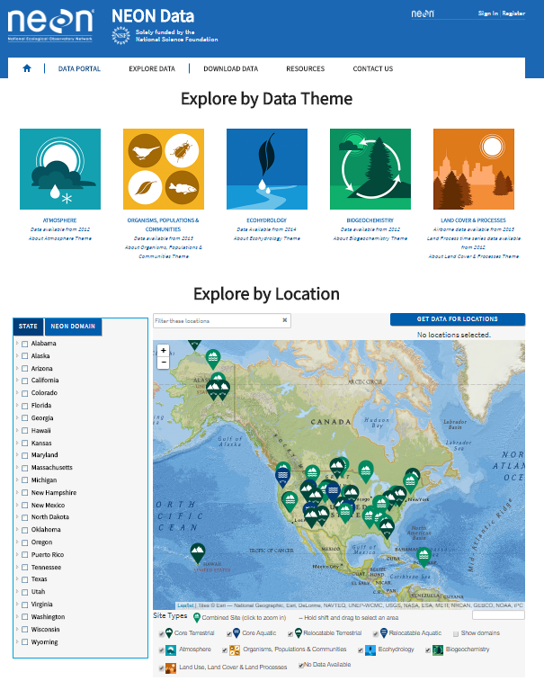
“NEON?... I’ve never heard of it”
Continental-scale ecological observatory
Open-access data, resources and infrastructure
Standardized measurements
Enable understanding of the effects of climate change, land use change, and invasive species on ecology

Slide 3
“NEON?... I’ve never heard of it”
Continental-scale ecological observatory
Open-access data, resources and infrastructure
Standardized measurements
Enable understanding of the effects of climate change, land use change, and invasive species on ecology
30-year time Observatory
2012 - 2018 (Construction Phase)
Building towers
Installing sensors
Algorithm Development
Data QC development
Data Commissioning

Slide 4
“NEON?... I’ve never heard of it”
Continental-scale ecological observatory
Open-access data, resources and infrastructure
Standardized measurements
Enable understanding of the effects of climate change, land use change, and invasive species on ecology
30-year time Observatory
2012 - 2018 (Construction Phase)
Building towers
Installing sensors
Algorithm Development
Data QC development
Data Commissioning

Slide 5
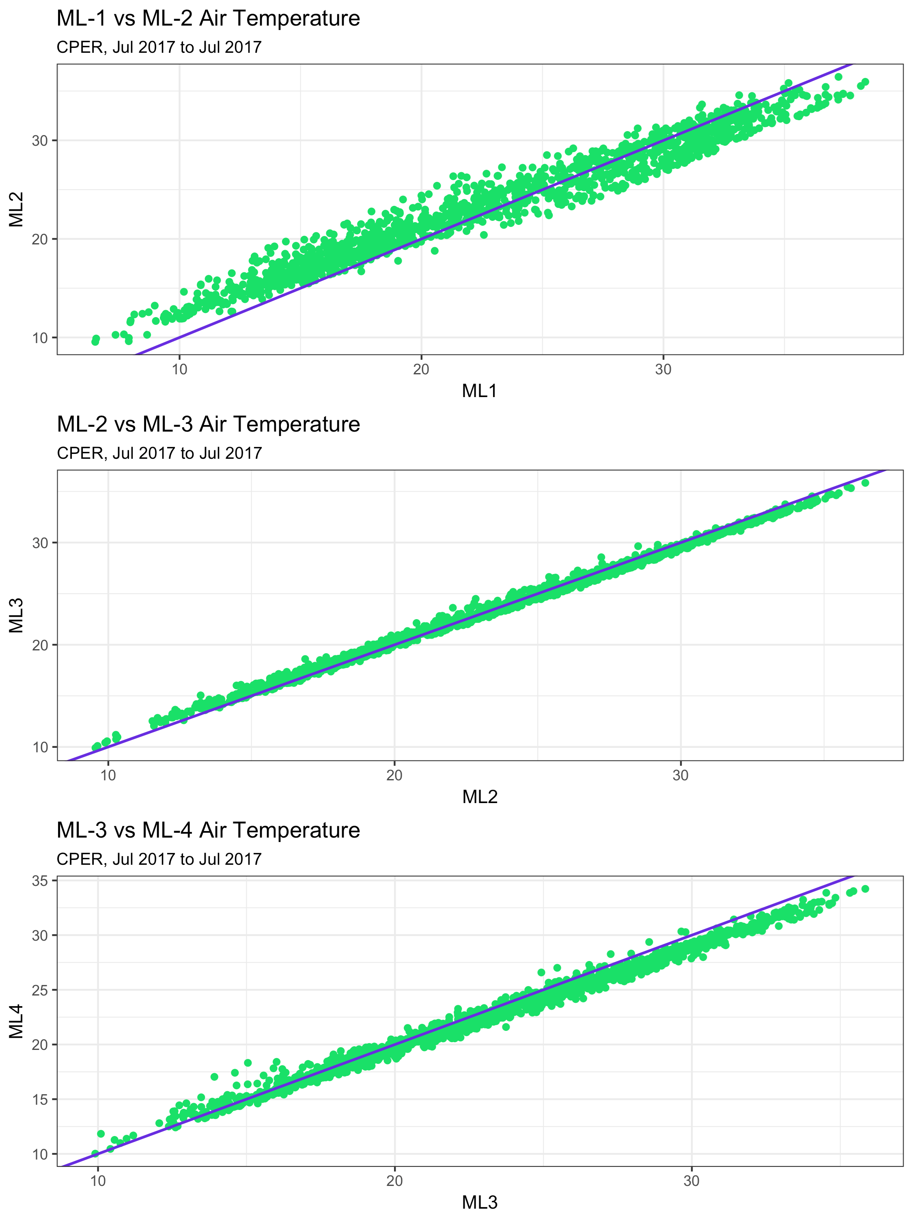
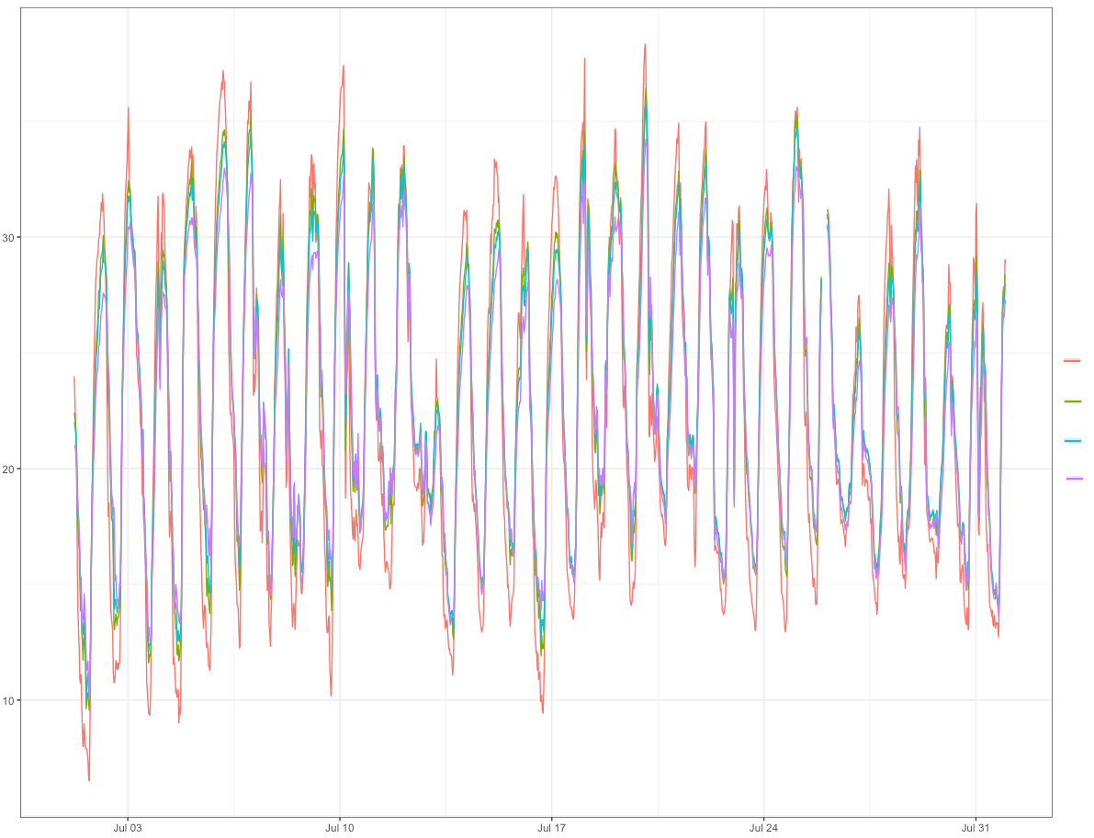
NEON data commissioning
Instrumented Systems (IS) Commissioning examines NEON data health by:
Verifying data quantity (> 95% availability)
Verifying data validity with internal quality reporting (> 90% pass QC tests)
Examining the health of data loggers
Examining correlations of data at different measurement heights
NEON-CPER
℃
ML 1
ML 2
ML 3
ML 4
Date

Slide 6
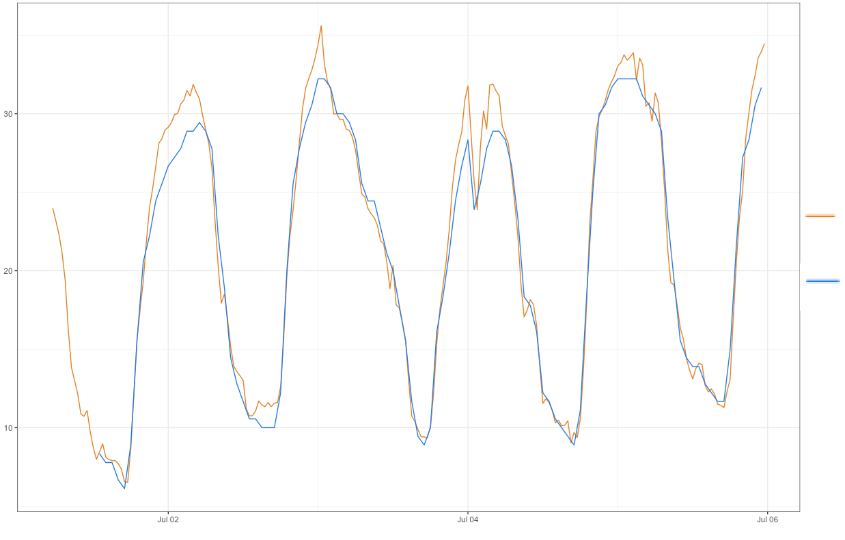
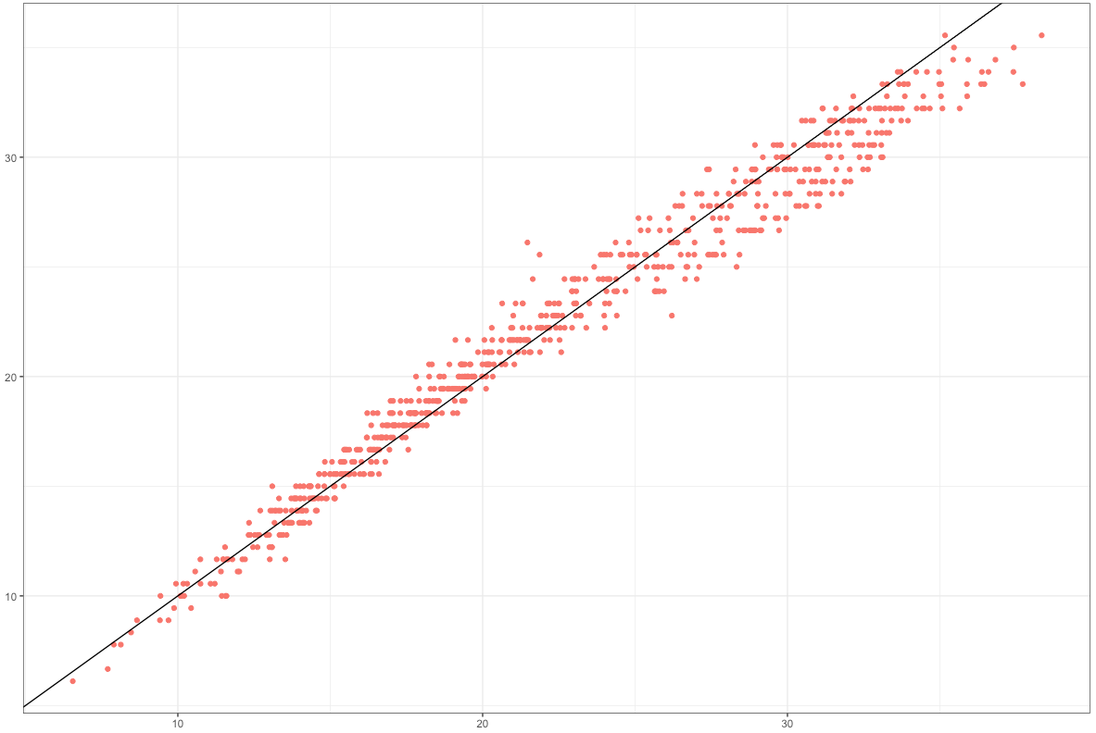
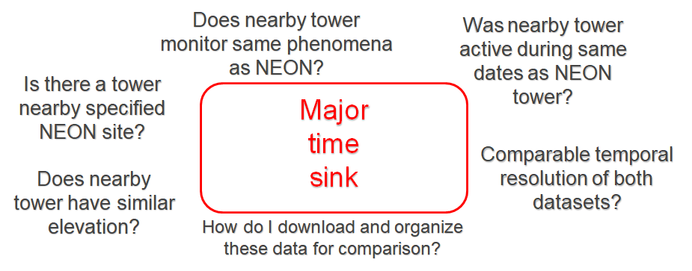
NEON data commissioning
Examining correlations between NEON data and data from nearby non-NEON sites
℃
NEON-CPER
SCAN-2197
SCAN-2197
Date
NEON-CPER

Slide 7
The Bigger Picture
I need [environmental phenomena] data for [spatial region of interest] from [start date] to [end date] that are produced every [temporal resolution]
Need accurate station metadata!!
Notes:
A big question in all of this is “where can I find the information I’m looking for?” If you’re a seasoned scientist this may be a no brainer, and you may know off the top of your head where you can find one-minute temperature data (for instance) in a certain region. But what if you’re looking for something very specific – a rarely measured phenomena, data for an area of the world you’re not familiar with, data from decades ago…. ?

Slide 8
The Bigger Picture
I need [environmental phenomena] data for [spatial region of interest] from [start date] to [end date] that are produced every [temporal resolution]
Need accurate station metadata!!
Site Name(s)
Site IDs (e.g., NCDC, WBAN, GHCND)
Platform(s) (e.g., COOP, AWOS, NEON)
Geolocation data
Latitude
Longitude
Elevation
Absolute dates (site)
Variables measured (e.g., air temp, precipitation, etc.)
active dates for each measured phenomenon
Temporal Resolution of data product(s)

Slide 9
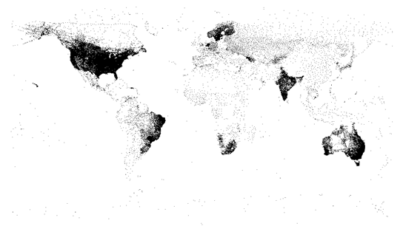
metScanR
A tool (R package + database) for locating, mapping, and gathering environmental data and metadata, worldwide.
>107,000 environmental monitoring stations among 219 countries/territories
Site Name(s)
Site IDs
Platform(s)
Geolocation data
Latitude
Longitude
Elevation
Absolute dates (site)
Variables measured
Active dates
Temporal Resolution
Plot of Lat. / lon. coordinates of every station in metScanR database
*Drastically mitigates time sink when searching for specific environmental data

Slide 10


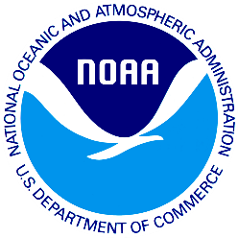


metScanR
Current input sources
Inspired by
…To be added in the future

Slide 11
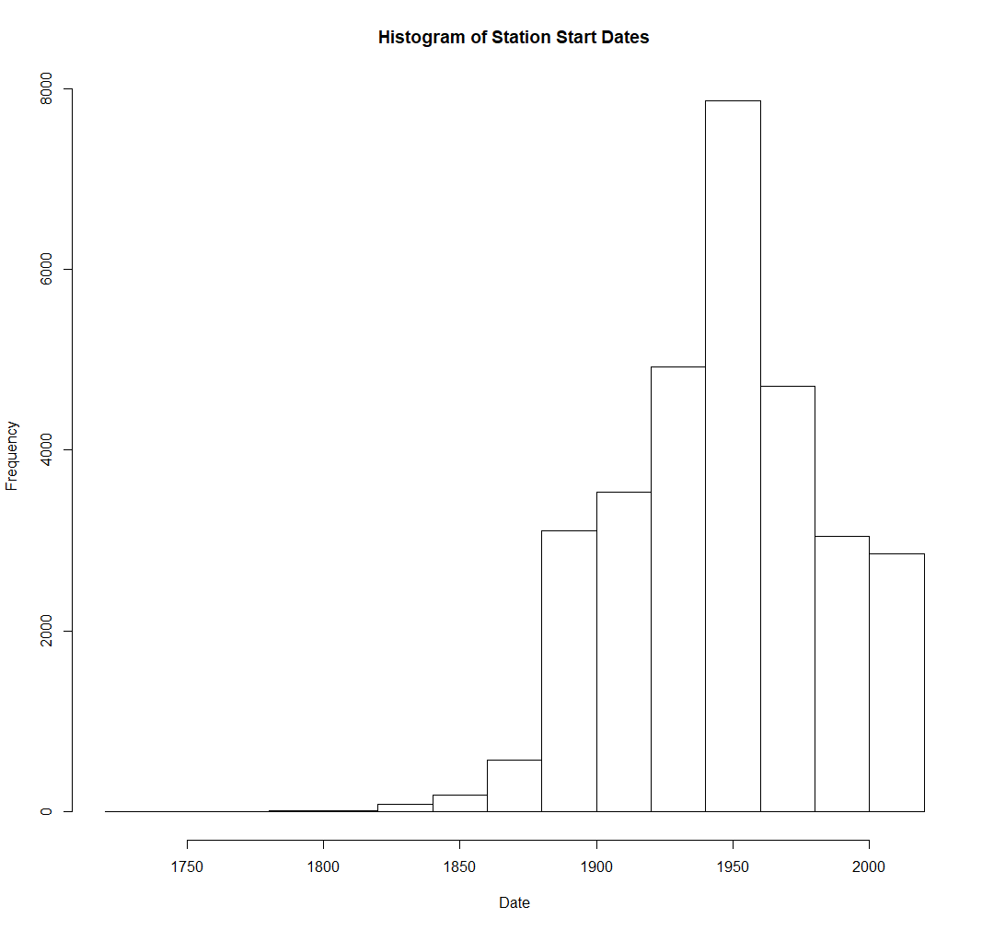
metScanR Database
107,126 stations
~29% w/ start dates
~71% w/o start dates
Oldest record
Downtown Charleston
Charleston, SC
1738!
Notes:
Although Evangelista Torricelli is universally credited with inventing the barometer in 1643, historical documentation also suggests Gasparo Berti, an Italian mathematician and astronomer, unintentionally built a water barometer sometime between 1640 and 1643.
Daniel Gabriel Fahrenheit (1686-1736) was the German physicist who invented the alcohol thermometer in 1709, and the mercury thermometer in 1714.

Slide 12
metScanR Database
107,126 stations
~29% w/ start dates
~71% w/o start dates
Oldest record
Downtown Charleston
Charleston, SC
1738!
Notes:
Although Evangelista Torricelli is universally credited with inventing the barometer in 1643, historical documentation also suggests Gasparo Berti, an Italian mathematician and astronomer, unintentionally built a water barometer sometime between 1640 and 1643.
Daniel Gabriel Fahrenheit (1686-1736) was the German physicist who invented the alcohol thermometer in 1709, and the mercury thermometer in 1714.

Slide 13
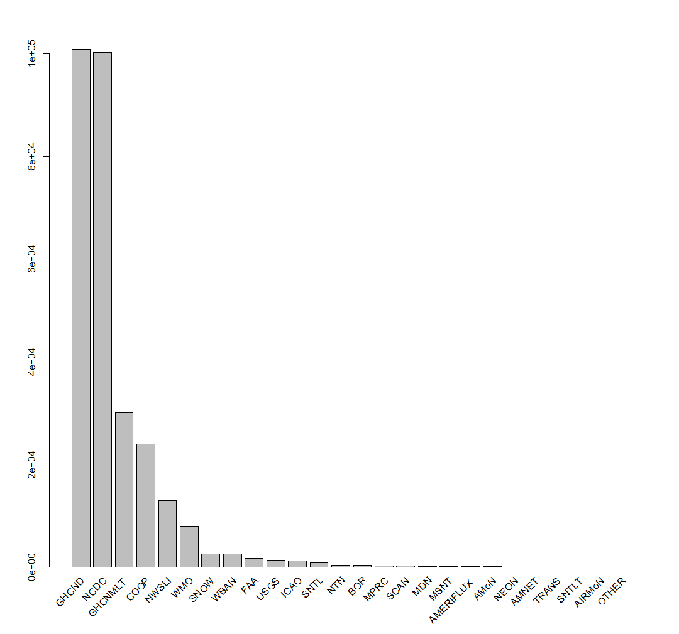
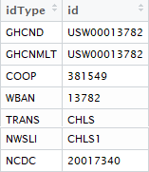
Handling the Metadata
A single station may be part of many networks, can have many associated identifiers…
Notes:
Although Evangelista Torricelli is universally credited with inventing the barometer in 1643, historical documentation also suggests Gasparo Berti, an Italian mathematician and astronomer, unintentionally built a water barometer sometime between 1640 and 1643.
Daniel Gabriel Fahrenheit (1686-1736) was the German physicist who invented the alcohol thermometer in 1709, and the mercury thermometer in 1714.

Slide 14
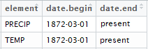
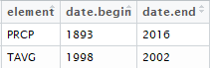
Handling the Metadata
A single station may be part of many networks, can have many associated identifiers… may have similar data product types stored among many repositories…
Same station & data products; Different repositories
Notes:
Although Evangelista Torricelli is universally credited with inventing the barometer in 1643, historical documentation also suggests Gasparo Berti, an Italian mathematician and astronomer, unintentionally built a water barometer sometime between 1640 and 1643.
Daniel Gabriel Fahrenheit (1686-1736) was the German physicist who invented the alcohol thermometer in 1709, and the mercury thermometer in 1714.

Slide 15
Handling the Metadata
A single station may be part of many networks, can have many associated identifiers… may have similar data product types stored among many repositories… which are available at different temporal resolutions
Daily and monthly data products
Hourly data products
Same station & data products; Different repositories & time scales
Notes:
Although Evangelista Torricelli is universally credited with inventing the barometer in 1643, historical documentation also suggests Gasparo Berti, an Italian mathematician and astronomer, unintentionally built a water barometer sometime between 1640 and 1643.
Daniel Gabriel Fahrenheit (1686-1736) was the German physicist who invented the alcohol thermometer in 1709, and the mercury thermometer in 1714.

Slide 16
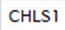
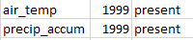
Handling the Metadata
A single station may be part of many networks, can have many associated identifiers… may have similar data product types stored among many repositories… which are available at different temporal resolutions
Daily and monthly data products
Hourly data products
10-minute data products
Same station & data products; Different repositories & time scales
Notes:
Although Evangelista Torricelli is universally credited with inventing the barometer in 1643, historical documentation also suggests Gasparo Berti, an Italian mathematician and astronomer, unintentionally built a water barometer sometime between 1640 and 1643.
Daniel Gabriel Fahrenheit (1686-1736) was the German physicist who invented the alcohol thermometer in 1709, and the mercury thermometer in 1714.

Slide 17
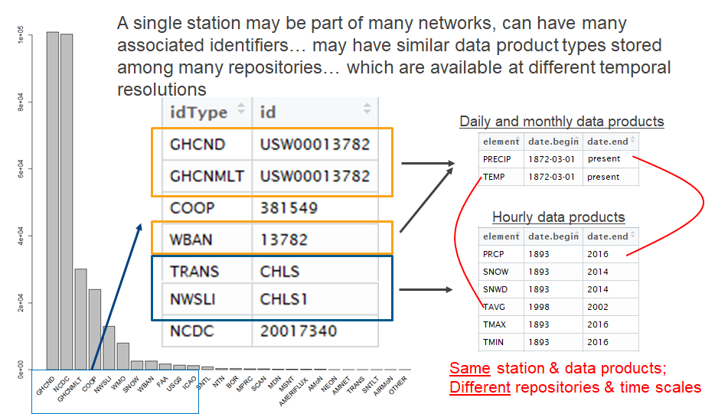
metScanR Database
10-minute data products
Notes:
Although Evangelista Torricelli is universally credited with inventing the barometer in 1643, historical documentation also suggests Gasparo Berti, an Italian mathematician and astronomer, unintentionally built a water barometer sometime between 1640 and 1643.
Daniel Gabriel Fahrenheit (1686-1736) was the German physicist who invented the alcohol thermometer in 1709, and the mercury thermometer in 1714.

Slide 18
metScanR Database
You get the idea..
10-minute data products
Notes:
Although Evangelista Torricelli is universally credited with inventing the barometer in 1643, historical documentation also suggests Gasparo Berti, an Italian mathematician and astronomer, unintentionally built a water barometer sometime between 1640 and 1643.
Daniel Gabriel Fahrenheit (1686-1736) was the German physicist who invented the alcohol thermometer in 1709, and the mercury thermometer in 1714.

Slide 19
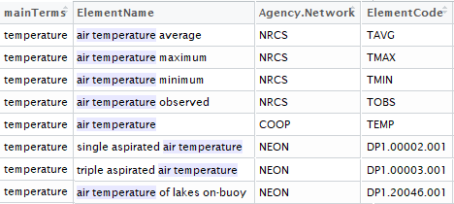
N-gram Search
Implemented a hierarchical n-gram search tool to account for nomenclature discrepancies among all networks.
N-grams:
n-gram | Definition | Example
Uni-gram | One word | Temperature
Bi-gram | Two words | Air Temperature
Tri-gram | Three words | Minimum Air Temperature Maximum Air Temperature Average Air Temperature Mean Air Temperature Air Temperature Mean Air Temperature Maximum Air Temperature Average Air Temperature Minimum …
ElementCode is needed for downloading data via Network APIs
Notes:
Multiple data repositories managed by different organizations results in discrepancies in nomenclature

Slide 20
N-gram Search
Implemented a hierarchical n-gram search tool to account for nomenclature discrepancies among all networks.
N-grams:
n-gram | Definition | Example
Uni-gram | One word | Temperature
Bi-gram | Two words | Air Temperature
Tri-gram | Three words | Minimum Air Temperature Maximum Air Temperature Average Air Temperature Mean Air Temperature Air Temperature Mean Air Temperature Maximum Air Temperature Average Air Temperature Minimum …
ElementCode is needed for downloading data via Network APIs
The metScanR database currently comprises 456 n-grams pertaining to environmental data.
abundantly measured phenomena (e.g., air temperature)
sparsely measured phenomena (e.g., soil microbe biomass)
Notes:
Multiple data repositories managed by different organizations results in discrepancies in nomenclature

Slide 21
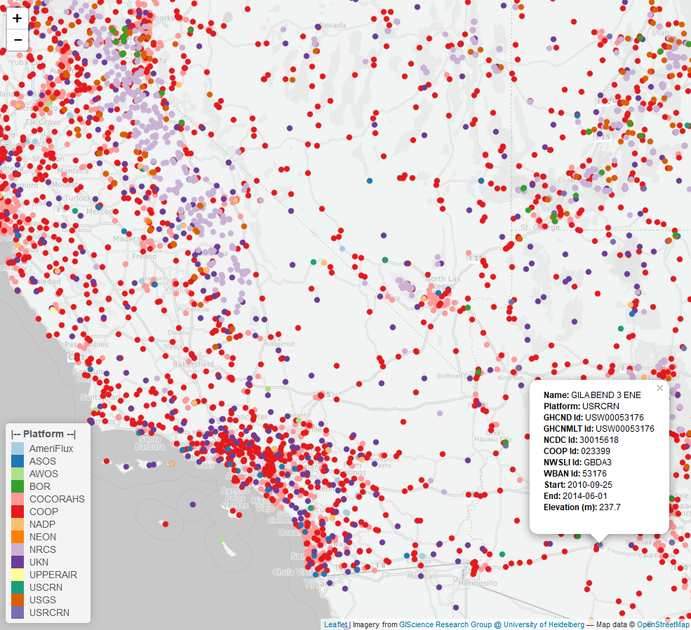
metScanR R Package
Features
Mitigates time sink
Users can search for and filter metadata from via:
Elevation
Location
Lat / Lon
Nearby POI
Active dates
Elements Measured
Country
Platform (network) type
ID type
Station ID
Station IDs Allow data to be downloaded from numerous databases

Slide 22
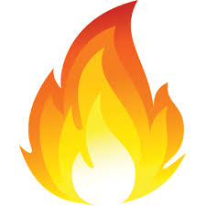
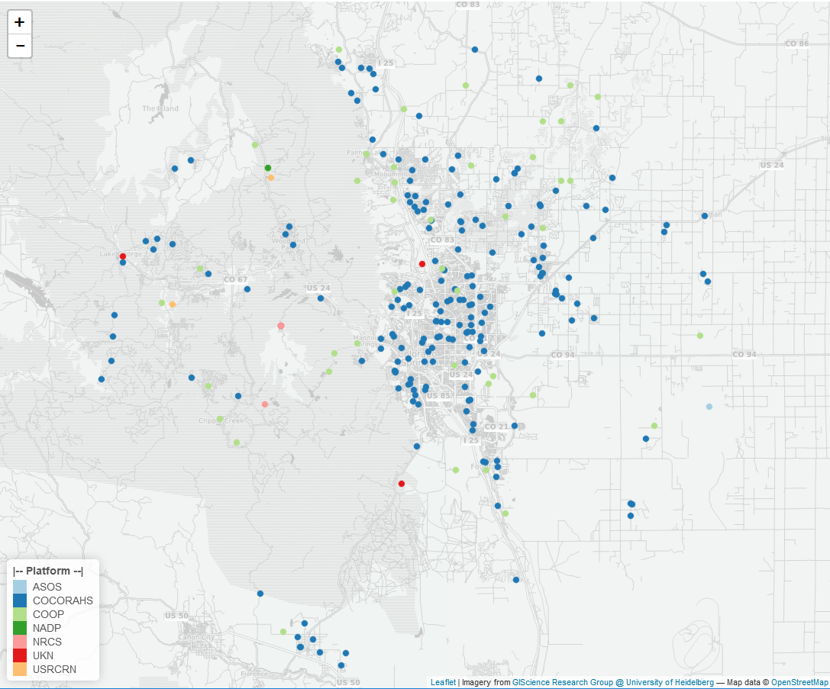
Use Case: 2012 Colorado Wildfires
I need daily soil moisture, precipitation, and snow depth data for Colorado Springs, CO from December 2011 through July 2012.
246 stations within 50 km of Waldo Canyon Fire
0 → soil moisture (closest is 120 km to northwest)
242 → precipitation
204 → snow depth
24 Stations within 15 km radius of fire bounds
24 → precipitation
22 → snow depth
(22 stations monitor both elements)
Notes:
The Waldo Canyon fire is a forest fire that started 10 miles (16 km) northwest of Colorado Springs on June 23, 2012, on July 8, 2012 the fire is 100 percent contained on 15,364 acres (24 sq mi; 62 km²) of US Forest Service land. The fire has caused the evacuation of over 32,000 residents of Colorado Springs, Manitou Springs and Woodland Park, several small mountain communities along Highway 24, and partial evacuation of the United States Air Force Academy. On the afternoon of June 26, winds increased following a dry thunderstorm that passed west of the fire, within two hours the fire which had been held by firefighters near Rampart Road jumped northeast into Queens Canyon as the fire crested out of Queens Canyon gusts as high as 70 mph pushed the fire down the front range particularly into the Mountain Shadows neighborhood. After 12 hours of fighting the blaze in western Colorado Springs the fire had claimed over 350 homes in Colorado Springs, thus making it the most destructive fire in Colorado state history by the number of houses burned.

Slide 23
Use Case: 2012 Colorado Wildfires
I need daily soil moisture, precipitation, and snow depth data for Colorado Springs, CO from December 2011 through July 2012.
246 stations within 50 km of Waldo Canyon Fire
0 → soil moisture (closest is 120 km to northwest)
242 → precipitation
204 → snow depth
24 Stations within 15 km radius of fire bounds
24 → precipitation
22 → snow depth
(22 stations monitor both elements)
16 stations: hourly & daily data
6 stations: monthly data
Notes:
The Waldo Canyon fire is a forest fire that started 10 miles (16 km) northwest of Colorado Springs on June 23, 2012, on July 8, 2012 the fire is 100 percent contained on 15,364 acres (24 sq mi; 62 km²) of US Forest Service land. The fire has caused the evacuation of over 32,000 residents of Colorado Springs, Manitou Springs and Woodland Park, several small mountain communities along Highway 24, and partial evacuation of the United States Air Force Academy. On the afternoon of June 26, winds increased following a dry thunderstorm that passed west of the fire, within two hours the fire which had been held by firefighters near Rampart Road jumped northeast into Queens Canyon as the fire crested out of Queens Canyon gusts as high as 70 mph pushed the fire down the front range particularly into the Mountain Shadows neighborhood. After 12 hours of fighting the blaze in western Colorado Springs the fire had claimed over 350 homes in Colorado Springs, thus making it the most destructive fire in Colorado state history by the number of houses burned.

Slide 24
Use Case: 2012 Colorado Wildfires
I need daily soil moisture, precipitation, and snow depth data for Colorado Springs, CO from December 2011 through July 2012.
246 stations within 50 km of Waldo Canyon Fire
0 → soil moisture (closest is 120 km to northwest)
242 → precipitation
204 → snow depth
24 Stations within 15 km radius of fire bounds
24 → precipitation
22 → snow depth
(22 stations monitor both elements)
16 stations: hourly & daily data
6 stations: monthly data
Go download data for 16 stations
RNRCS
rnoaa
nneo
Notes:
The Waldo Canyon fire is a forest fire that started 10 miles (16 km) northwest of Colorado Springs on June 23, 2012, on July 8, 2012 the fire is 100 percent contained on 15,364 acres (24 sq mi; 62 km²) of US Forest Service land. The fire has caused the evacuation of over 32,000 residents of Colorado Springs, Manitou Springs and Woodland Park, several small mountain communities along Highway 24, and partial evacuation of the United States Air Force Academy. On the afternoon of June 26, winds increased following a dry thunderstorm that passed west of the fire, within two hours the fire which had been held by firefighters near Rampart Road jumped northeast into Queens Canyon as the fire crested out of Queens Canyon gusts as high as 70 mph pushed the fire down the front range particularly into the Mountain Shadows neighborhood. After 12 hours of fighting the blaze in western Colorado Springs the fire had claimed over 350 homes in Colorado Springs, thus making it the most destructive fire in Colorado state history by the number of houses burned.

Slide 25
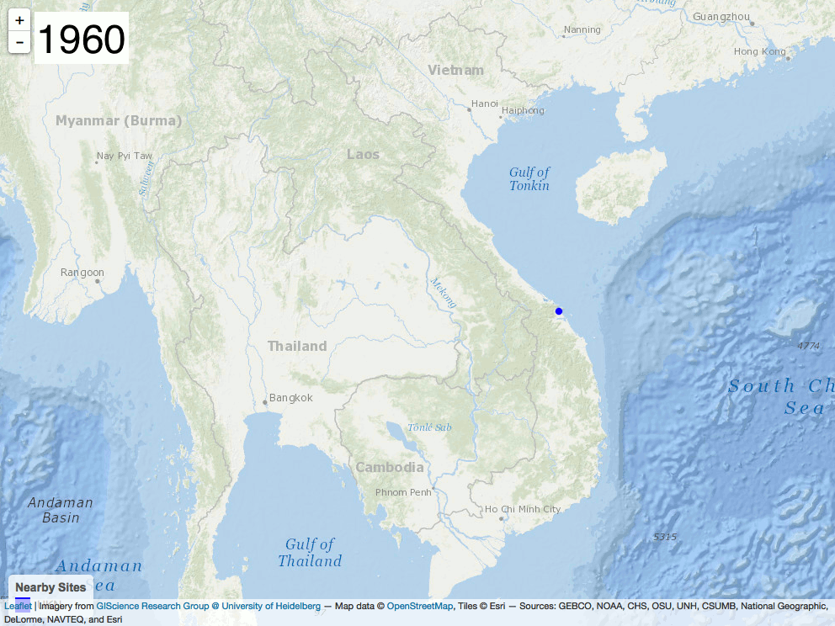
Operation Popeye
A highly classified weather modification program in SE Asia during Vietnam War
When?
3/20/1967 to 7/5/1972
What?
Cloud Seeding
Why?
Extend Monsoon Season
over Ho Chi Minh Trail
Who?
54th Weather Reconnaissance
Squadron via CIA et al.
“Make mud, not war”

Slide 26
Continued and Future Goals
Package updates every 3 to 6 months
Filter data by:
US State
Temporal availability of data (in progress)
Additions of following networks:
LTER
ARM
GNIP
Mesowest (in progress)*
Data downloads and merging (link metScanR to other R packages):
RNRCS – NRCS data
nneo – NEON data
rnoaa – NOAA / HOMR data

